Slide 1

Overview of Methodologies Reiterations

Slide 2
Overview of Concepts, Data, Methods, & Metrics
Measures calculated over the past year & dependent on testing data availability.
Concepts
Data
Methods
Metrics
FIND & Our World in Data (OWID) COVID-19 case data
Test positivity rate (TPR) in the last year = total # of COVID-19 cases/total # of COVID-19 tests
Average daily testing per 1000 persons in the last year = mean (# of COVID-19 tests per day)
Demonstrated Testing & Reporting Capacity:
Countries reporting < 15% TPR, or >1 average daily testing per 1000 persons
COVID-19 Diagnostic
Testing Capacity
WHO NGS capacity & proprietary manufacturer device data
Categorical data:
0 facilities or installed devices identified
1-3 facilities & equivalent device access
4+ facilities & equivalent device access
Demonstrated Sequencing Facility Access:
Countries reporting 1 or more facility & manufacturer bases
Next-Generation Sequencing Facility Access
Percent (%) of cases sequenced in the last year = # of SARS-CoV-2 cases sequenced/# of COVID-19 cases
Cumulative number of sequences
per 100,000 persons in the last year = # of SARS-CoV-2 sequences
Demonstrated SARS-CoV-2 Sequencing & Reporting Capacity:
Countries reporting > 0.5% of cases sequenced or >30 sequences per 100K persons
OWID case data & GISAID
sequencing
data
SARS-CoV-2 Sequencing Capacity
Notes:
Measures – title of maps
Data
Metrics
Thresholds – insufficient/sufficient

Slide 3
Overview of Archetypes, Data, Methods, & Metrics
Measures calculated over the past year & dependent on testing data availability.
Archetypes
Data
Methods
Metrics
FIND & Our World in Data (OWID) COVID-19 case data
Test positivity rate (TPR) in the last year = total # of COVID-19 cases/total # of COVID-19 tests
Average daily testing per 1000 persons in the last year = mean (# of COVID-19 tests per day)
Demonstrated Testing & Reporting Capacity:
Countries reporting < 15% TPR, or >1 average daily testing per 1000 persons
Test
Percent (%) of cases sequenced in the last year = # of SARS-CoV-2 cases sequenced/# of COVID-19 cases
Cumulative number of sequences
per 100,000 persons in the last year = # of SARS-CoV-2 sequences
Demonstrated SARS-CoV-2 Sequencing & Reporting Capacity:
Countries reporting > 0.5% of cases sequenced or >30 sequences per 100K persons
OWID case data & GISAID
sequencing
data
Strengthen
WHO NGS capacity & proprietary manufacturer device data
Categorical data:
0 facilities or installed devices identified
1-3 facilities & equivalent device access
4+ facilities & equivalent device access
Demonstrated Sequencing Facility Access:
Countries reporting 1 or more facility & manufacturer bases
Connect
&
Leverage
Notes:
Measures – title of maps
Data
Metrics
Thresholds – insufficient/sufficient

Slide 4
Overview of Concepts, Data, Methods, & Metrics
Measures calculated over the past year & dependent on testing data availability.
Concepts
Data
Methods
Metrics
FIND Test Tracker¹ & Our World in Data (OWID)² COVID-19 data
Test positivity rate (TPR) in the last year = total # of COVID-19 cases/total # of COVID-19 tests
Average daily testing per 1000 persons in the last year = mean (# of COVID-19 tests per day)
Demonstrated Testing & Reporting Capacity:
Countries reporting < 15% TPR, or >1 average daily testing per 1000 persons
COVID-19 Diagnostic
Testing Capacity
Percent (%) of cases sequenced in the last year = # of SARS-CoV-2 cases sequenced/# of COVID-19 cases
Cumulative number of sequences
per 100,000 persons in the last year = # of SARS-CoV-2 sequences
Demonstrated SARS-CoV-2 Sequencing & Reporting Capacity:
Countries reporting > 0.5% of cases sequenced or >30 sequences per 100K persons
OWID data & GISAID
sequencing
data³
SARS-CoV-2 Sequencing Capacity
WHO NGS capacity⁴ & proprietary manufacturer device data
Categorical data:
0 facilities or installed devices identified
1-3 facilities & equivalent device access
4+ facilities & equivalent device access
Demonstrated Sequencing Facility Access:
Countries reporting 1 or more facility & manufacturer bases
Next-Generation Sequencing Facility Access
Notes:
Measures – title of maps
Data
Metrics
Thresholds – insufficient/sufficient

Slide 5
Overview of Concepts, Data, Methods, & Metrics
Measures calculated over the past year & dependent on testing data availability.
Concepts
Data
Methods
Metrics
Percent (%) of cases sequenced in the last year = # of SARS-CoV-2 cases sequenced/# of COVID-19 cases
Cumulative number of sequences
per 100,000 persons in the last year = # of SARS-CoV-2 sequences
Demonstrated SARS-CoV-2 Sequencing & Reporting Capacity:
Countries reporting > 0.5% of cases sequenced or >30 sequences per 100K persons
Our World in Data¹ COVID-19 data & GISAID²
sequencing
data
NGS SARS-CoV-2 Sequencing Capacity
WHO NGS capacity & proprietary manufacturer device data
Categorical data:
0 facilities or installed devices identified
1-3 facilities & equivalent device access
4+ facilities & equivalent device access
Demonstrated Sequencing Facility Access:
Countries reporting 1 or more facility & manufacturer bases
NGS Facility Access
Demonstrated Testing & Reporting Capacity:
Countries reporting < 15% TPR, or >1 average daily testing per 1000 persons
FIND Test Tracker³ & Our World in Data COVID-19 data
Test positivity rate (TPR) in the last year = total # of COVID-19 cases/total # of COVID-19 tests
Average daily testing per 1000 persons in the last year = mean (# of COVID-19 tests per day)
COVID-19 Diagnostic
Testing Capacity
Notes:
Measures – title of maps
Data
Metrics
Thresholds – insufficient/sufficient

Slide 6
Classification Scheme Reiterations

Slide 7
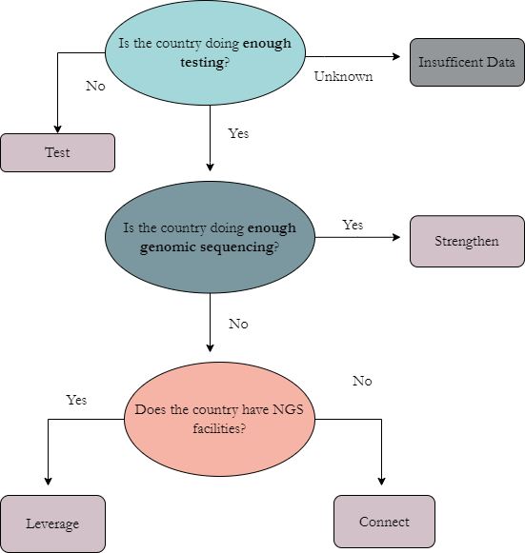
Overview of Hierarchical Classification Scheme

Slide 8
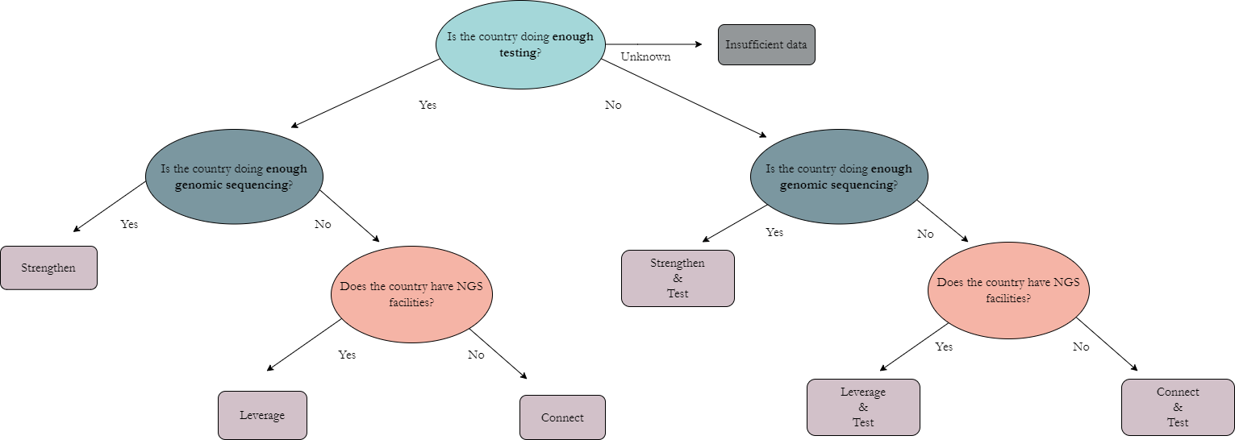
Overview of Hierarchical Classification Scheme

Slide 9
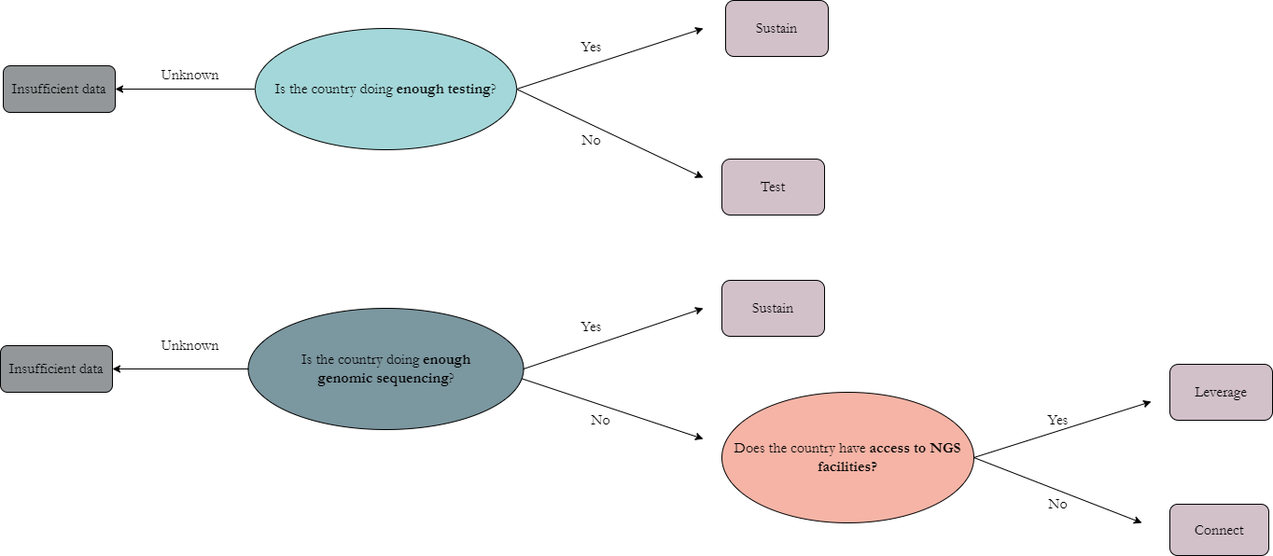
Parallel Diagnostic & NGS Archetype Classification Scheme

Slide 10
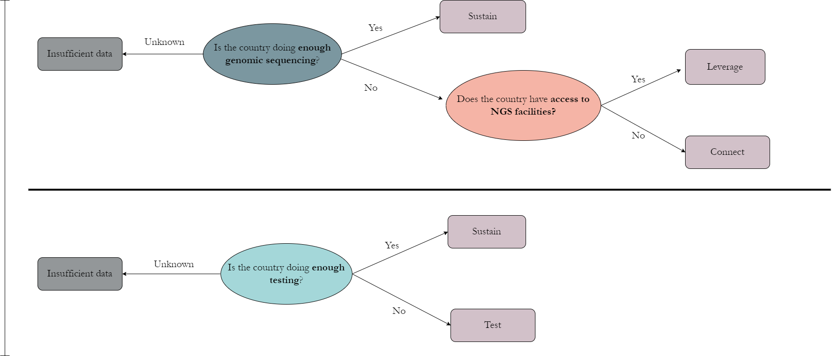
Parallel NGS & Diagnostic Archetype Classification Scheme

Slide 11
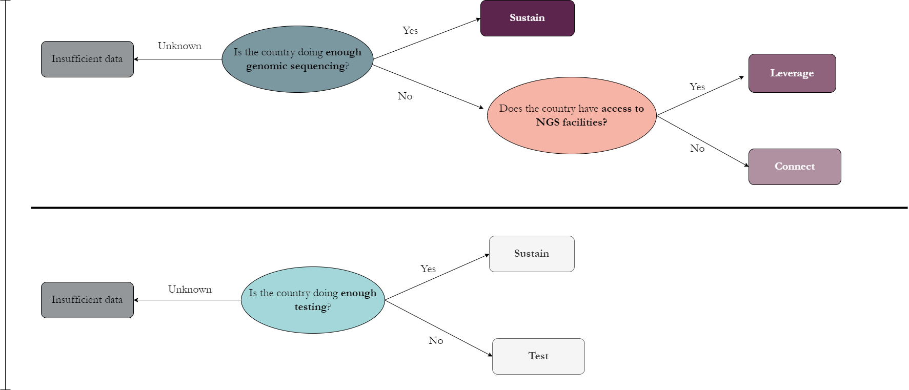
Parallel NGS & Diagnostic Archetype Classification Scheme

Slide 12

Parallel NGS & Diagnostic Archetype Classification Scheme

Slide 13
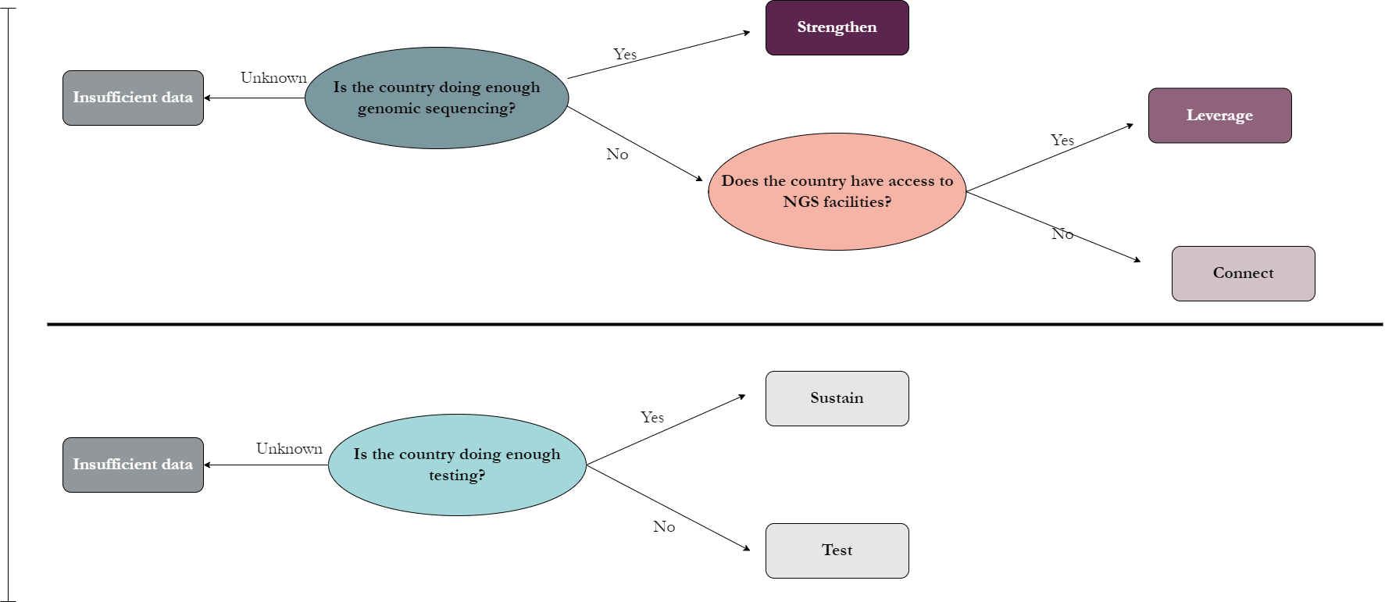
Parallel NGS & Diagnostic Archetype Classification Scheme

Slide 14
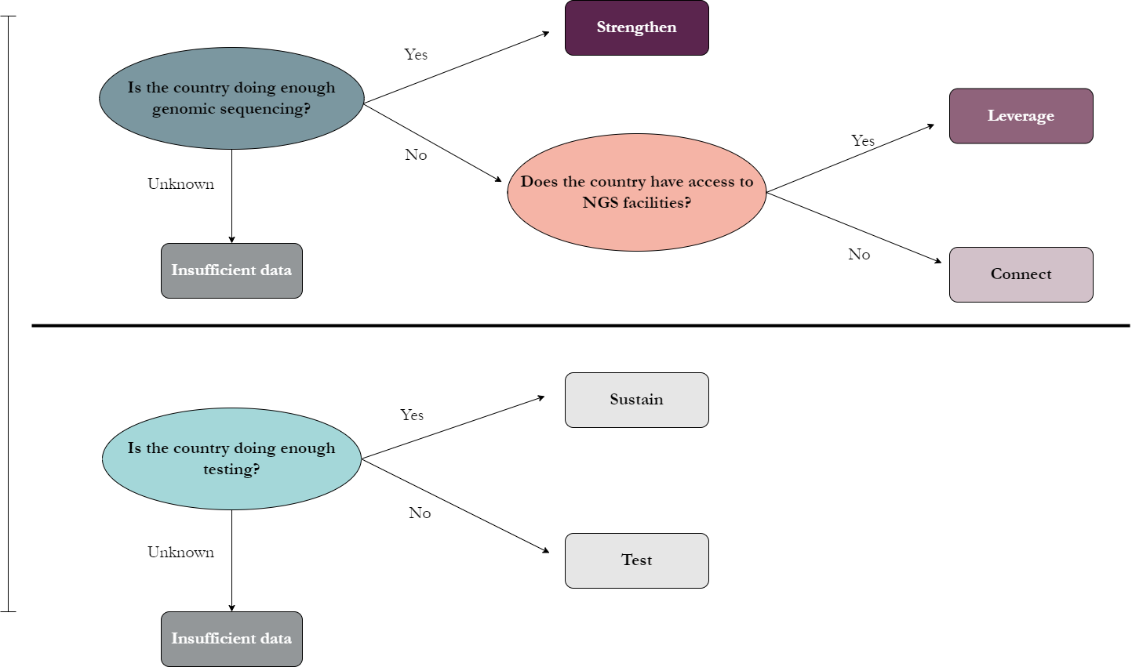
Independent NGS & Diagnostic Archetype Classification Scheme

Slide 15
Recommendations Reiterations

Slide 16
Overview of Archetypes, Descriptions, & Recommendations
Country archetypes updated on a monthly basis
Archetype | Description | Recommendations
Test | Has not demonstrated diagnostic testing & reporting capacity for COVID-19. | Develop sufficient¹ diagnostic testing capacity for COVID-19.
Connect | Demonstrated testing & reporting capacity for COVID-19, has not demonstrated SARS-CoV-2 sequencing and reporting, and has no NGS facilities identified domestically. | Set-up sample referral networks to utilize regional NGS capacity or build NGS capacity from scratch.
Leverage | Demonstrated testing & reporting capacity for COVID-19, has access to NGS facilities domestically but has not demonstrated SARS-CoV-2 sequencing & reporting capacity. | Perform situational analysis to identify potential ways to leverage or repurpose existing NGS facility access for SARS-CoV-2 genomic surveillance.
Strengthen | Demonstrated testing & reporting capacity for COVID-19, NGS facilities present domestically, and demonstrated SARS-CoV-2 sequencing & reporting capacity. | Expand existing sequencing & reporting capacity to scale-up ongoing sufficient² SARS-CoV-2 genomic surveillance.

Slide 17
Overview of Archetypes, Descriptions, & Recommendations
Country archetypes updated on a monthly basis
Archetype | Description | Priority Recommendations
Connect | Country data has not identified NGS facilities domestically. | Set-up sample referral networks to utilize regional NGS capacity or build NGS capacity from scratch.
Leverage | Country data demonstrated access to NGS facilities domestically. | Perform situational analysis to identify potential ways to leverage or repurpose existing NGS facility access for SARS-CoV-2 genomic surveillance.
Strengthen | Country data demonstrated SARS-CoV-2 RNA sequencing & reporting capacity. | Expand existing sequencing & reporting capacity to scale-up ongoing sufficient² SARS-CoV-2 genomic surveillance.
Test | Country has not demonstrated diagnostic testing & reporting capacity for COVID-19. | Develop sufficient¹ diagnostic testing capacity for COVID-19.

Slide 18
Overview of Archetypes, Descriptions, & Recommendations
Country archetypes updated on a monthly basis
Concept | Archetype | Description | Recommendations
NGS SARS-CoV-2 Sequencing and Facility Access Capacity | Sustain | Country data demonstrated SARS-CoV-2 RNA sequencing & reporting capacity. | Sustain and expand genomic sequencing & reporting capacity
 | Leverage | Country data demonstrated access to NGS facilities domestically. | Perform situational analysis to identify potential ways to leverage or repurpose existing NGS facility access for genomic surveillance.
 | Connect | Country data has not identified NGS facilities domestically. | Set-up sample referral networks to utilize regional NGS capacity or build NGS capacity from scratch.
Diagnostic Testing Capacity | Sustain | Country has demonstrated COVID-19 diagnostic testing & reporting capacity | Sustain and expand diagnostic testing & reporting capacity
 | Test | Country has not demonstrated diagnostic testing & reporting capacity for COVID-19. | Develop sufficient¹ diagnostic testing capacity.

Slide 19
Overview of Archetypes, Descriptions, & Recommendations
Country archetypes updated on a monthly basis
Concept | Archetype | Description | Recommendations
NGS SARS-CoV-2 Sequencing and Facility Access Capacity | Sustain | Country data demonstrated SARS-CoV-2 RNA sequencing & reporting capacityt¹. | Sustain and expand genomic sequencing & reporting capacity
 | Leverage | Country data demonstrated access to NGS facilities domesticallyt². | Perform situational analysis to identify potential ways to leverage or repurpose existing NGS facility access for genomic surveillance.
 | Connect | Country data has not identified NGS facilities domestically. | Set-up sample referral networks to utilize regional NGS capacity or build NGS capacity from scratch.
Diagnostic Testing Capacity | Sustain | Country has demonstrated COVID-19 diagnostic testing & reporting capacityt³. | Sustain and expand diagnostic testing & reporting capacity
 | Test | Country has not demonstrated diagnostic testing & reporting capacity. | Develop sufficient diagnostic testing capacity.

Slide 20
Overview of Archetypes, Descriptions, & Recommendations
Country archetypes updated on a monthly basis
Concept | Archetype | Description | Recommendations
NGS SARS-CoV-2 Sequencing and Facility Access Capacity | Strengthen | Country data demonstrated SARS-CoV-2 RNA sequencing & reporting capacityt¹. | Sustain and expand genomic sequencing & reporting capacity
 | Leverage | Country data demonstrated access to NGS facilities domesticallyt². | Perform situational analysis to identify potential ways to leverage or repurpose existing NGS facility access for genomic surveillance.
 | Connect | Country data has not identified NGS facilities domestically. | Set-up sample referral networks to utilize regional NGS capacity or build NGS capacity from scratch.
Diagnostic Testing Capacity | Sustain | Country has demonstrated COVID-19 diagnostic testing & reporting capacityt³. | Sustain and expand diagnostic testing & reporting capacity
 | Test | Country has not demonstrated diagnostic testing & reporting capacity. | Develop sufficient diagnostic testing capacity.

Slide 21
Overview of Archetypes, Descriptions, & Recommendations
Country archetypes updated on a monthly basis
Concept | Archetype | Description | Recommendations
NGS SARS-CoV-2 Sequencing and Facility Access Capacity | Strengthen | Country has demonstrated SARS-CoV-2 sequencing & reporting capacity¹. | Strengthen and expand genomic sequencing & reporting capacity
 | Leverage | Country has demonstrated access to NGS facilities². | Perform situational analysis to identify potential ways to leverage or repurpose existing NGS facility access for genomic surveillance.
 | Connect | Country has not demonstrated access to NGS facilities. | Set-up sample referral networks to utilize regional NGS capacity or build NGS capacity from scratch.
Diagnostic Testing Capacity | Sustain | Country has demonstrated COVID-19 diagnostic testing & reporting capacity³. | Sustain and expand diagnostic testing & reporting capacity
 | Test | Country has not demonstrated COVID-19 diagnostic testing & reporting capacity. | Develop sufficient diagnostic testing capacity.

Slide 22
Overview of Archetypes, Descriptions, & Recommendations
Country archetypes updated on a monthly basis
Concept | Archetype | Description | Recommendations
NGS SARS-CoV-2 Sequencing and Facility Access Capacity | Strengthen | Country data demonstrated SARS-CoV-2 RNA sequencing & reporting capacityt¹. | Sustain and expand genomic sequencing & reporting capacity
 | Leverage | Country data demonstrated access to NGS facilities domesticallyt². | Perform situational analysis to identify potential ways to leverage or repurpose existing NGS facility access for genomic surveillance.
 | Connect | Country data has not identified NGS facilities domestically. | Set-up sample referral networks to utilize regional NGS capacity or build NGS capacity from scratch.
Diagnostic Testing Capacity | Sustain | Country has demonstrated COVID-19 diagnostic testing & reporting capacityt³. | Sustain and expand diagnostic testing & reporting capacity
 | Test | Country has not demonstrated diagnostic testing & reporting capacity. | Develop sufficient diagnostic testing capacity.

Slide 23
Overview of Archetypes, Descriptions, & Recommendations
Country archetypes updated on a monthly basis
Concept | Archetype | Description | Recommendations
NGS SARS-CoV-2 Sequencing and Facility Access Capacity | Strengthen | Country has demonstrated SARS-CoV-2 sequencing & reporting capacity¹. | Strengthen and expand SARS-CoV-2 genomic sequencing & reporting capacity
 | Leverage | Country has demonstrated access to NGS facilities². | Perform situational analysis to identify potential ways to leverage or repurpose existing NGS facility access for genomic surveillance.
 | Connect | Country has not demonstrated access to NGS facilities. | Set-up sample referral networks to utilize regional NGS capacity or build NGS capacity from scratch.
Diagnostic Testing Capacity | Sustain | Country has demonstrated COVID-19 diagnostic testing & reporting capacity³. | Sustain and expand COVID-19 diagnostic testing & reporting capacity
 | Test | Country has not demonstrated diagnostic testing & reporting capacity. | Develop sufficient diagnostic testing capacity.

Slide 24
Equations Reiterations

Slide 25
Formula Visuals for Paper
Test positivity rate (TPR) (%) =
∑ (COVID-19 cases)
__________________________ × 100
∑ (COVID-19 tests)
Average daily testing per 1000 persons =
COVID-19 tests per day
µ _________________________________ × 1000
Population

Slide 26
Formula Visuals for Paper
Percent (%) of cases sequenced =
∑ (SARS-CoV-2 cases sequenced)
__________________________ × 100
∑ (COVID-19 cases)
Cumulative number of sequences per 100,000 persons =
∑ (SARS-CoV-2 sequences)
__________________________ × 100000
Population

Slide 27
Archived Archetype Methodologies (2021)

Slide 28
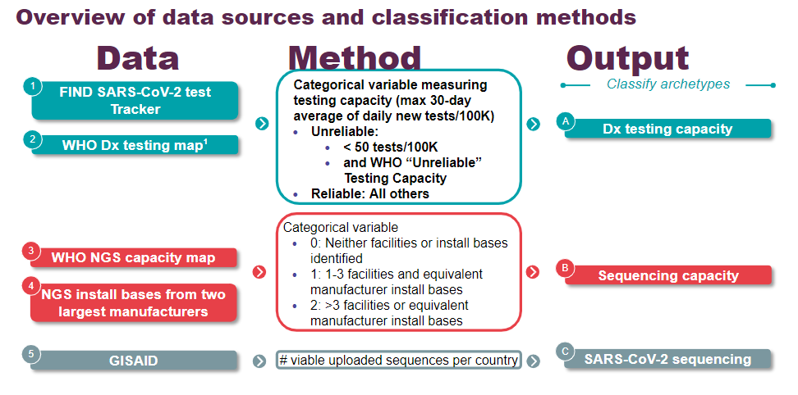

Slide 29
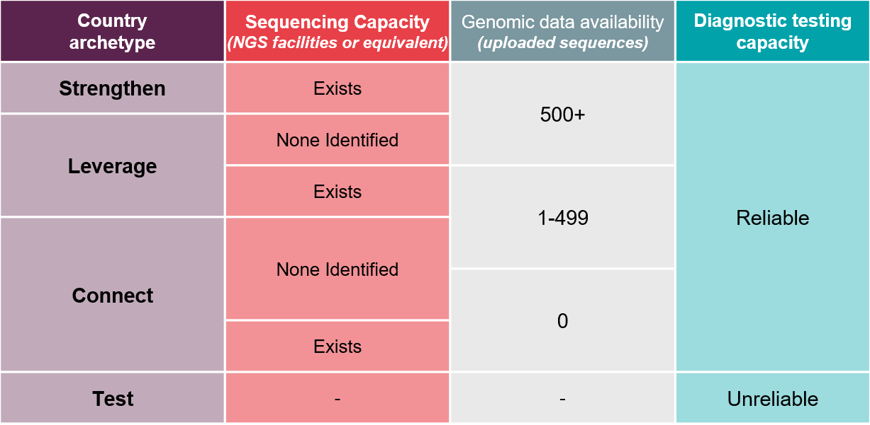

Slide 30
NGS Working Session and Reiterations
March 2022

Slide 31
Appendix
March 2022

